Slide 1
DIGITAL DISPLACEMENT TRANSDUCERS

Slide 2
Transducers often communicate with digital computers.
Transducers with digital output would be particularly convenient.
However, very few such devices exist, so usually we use an analog transducer to produce a voltage signal and an electronic analog-to-digital converter to realize the desired digital data.
Digital transducers called encoders do exist, however, for translational and rotary displacement and are in wide use.
For translational and rotary displacement, 3 major classes are used,
Tachometer
Incremental
Absolute

Slide 3
TACHOMETER ENCODER
A tachometer encoder has only a single output signal which consists of a pulse for each increment of displacement.
If motion were always in one direction, a digital
counter could accumulate these pulses to determine displacement from a known starting point.
However, any reversed motion would produce identical pulses, causing errors.
Thus this type of encoder usually is used for speed, rather than displacement, measurement in situations where rotation never reverses.

Slide 4
INCREMENTAL ENCODER
The incremental encoder solves the reverse-motion problem by employing at least two (and sometimes three) signal-generating elements.
By mechanically displacing the two tracks, one of the electric signals is shifted 1/4 cycle relative to theother, allowing detection of motion direction by noting which signal rises first.
Thus the up-down pulse counter can be signaled to subtract pulses whenever motion reverses.
A third output, which produces a single pulse per revolution at a distinct point, is sometimes provided as a zero reference.

Slide 5
ADVANTAGE
An incremental encoder has the advantage of being able to rotate through as many revolutions as the application
requires.
DISADVANTAGE
Any false pulses resulting from electric noise will cause errors that persist even when the noise disappears, and loss of system power also causes total loss of position data with no recovery when power is reapplied.

Slide 6
ABSOLUTE ENCODERS
Absolute encoders generally are limited to a single revolution and utilize multiple tracks and outputs, which are read out in parallel to produce a binary, representation of the angular position of the shaft.
Since there is a one-to-one correspondence between shaft position and binary output, position data are recovered when power is restored after an outage, and transient electric noise causes only transient measurement error.

Slide 7
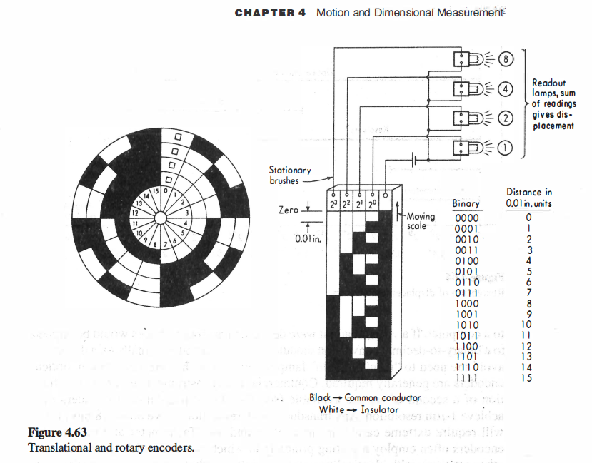

Slide 8
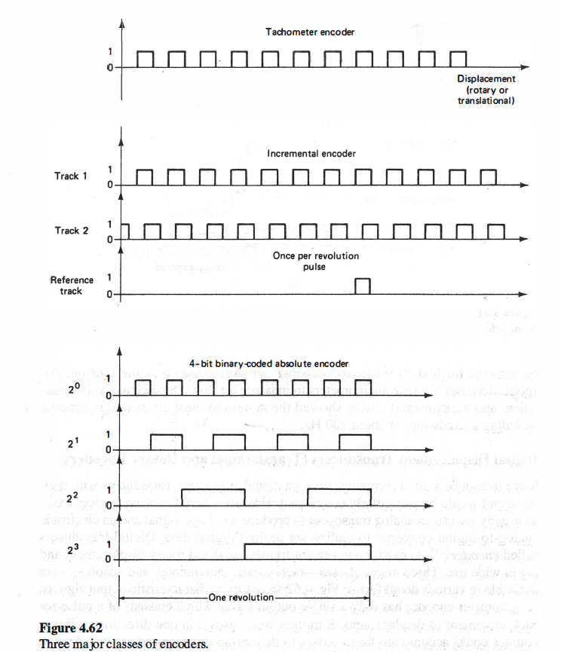

Slide 9
RESOLUTION
For the finest resolution, optical encoders are generally required.
Commercial rotary instruments that resolve a fraction of a second of arc are available translational encoders may achieve 1μm resolution. Any transducer with resolution above about 1 8 bits (1/218) will require extreme care in installation and use.

Slide 10
OPTICAL ENCODERS
Tachometer and incremental encoders often employ a grating principle in which two glass disks (one fixed, the other rotating), with identical opaque/clear patterns photographically deposited, are mounted side by side with about 0.0 1-in clearance between.
Parallel light is projected through the two disks toward photosensors on the far side. When opaque segments are aligned, a minimum (logical 0) signal is produced while alignment of clear segments gives a maximum (logical 1 ) signal.

Slide 11
Absolute encoders may use the demagnification method in which the light is sharply focused, rather than parallel, and only one disk is employed, with the narrow light beam and photosensor acting in the same fashion as the brushes in a contacting encoder.
By use of a semiconductor laser light source, encoders of 81,000 pulses per revolution can be achieved with a 36-mm diameter.
External interpolating electronics can increase the
resolution to about 10 million pulses per revolution.

Slide 12
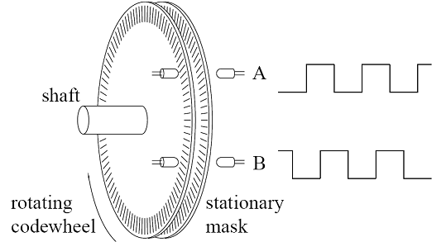
OPTICAL ENCODERS - A ROUGH REPRESENTATION

Slide 13
While incremental and absolute encoders are today the major types available for position measurement, a third class has recently appeared that may be preferred for some types of applications.
These are called pseudo random encoders, marketed by Gurley as "VIRTUAL ABSOLUTE."

Slide 14
VIRTUAL ABSOLUTE
Their size and mechanical construction is similar to a incremental encoder, but they have a third track that carries a uniquely coded pattern called a pseudorandom sequence.
The pseudorandom device can locate its absolute position, wherever it might currently be, by making any small motion about 1 or 2 degrees for rotary devices, 1mm for translatory measurement.
After a power interruption we lose absolute position until we make the required small move.

